Slide 1
Java 4 WEB
Lesson 6 - Generics, Comparator, Comparable

Slide 2
Lesson goals
Generics
Collections class
Comparator vs Comparable

Slide 3
Generics
List someList = new ArrayList(); someList.add(1); // 1 someList.add("A string"); // A string someList.add(new Object()); // java.lang.Object@6474c2 someList.add(new ArrayList<>()); // [] someList.add(someList); // (this Collection) someList.add(new Exception()); // java.lang.Exception
print((String) someList.get(0)); // throws java.lang.ClassCastException

Slide 4

Generics, diamond operator
List names = new ArrayList(); // Java 1+
List<String> names = new ArrayList<String>(); // Java 5+
List<String> names = new ArrayList<>(); // Java 7+
var names = new ArrayList<String>(); // Java 10+
Notes:
Before Java 5 came out, you had to write code like the following
and hope that programmers remembered that you wanted only String objects in there

Slide 5
Generics usage
public class Box<T> { private T contents; public T openBox() { return contents; } public void packBox(T contents) { this.contents = contents; } }
Box<String> box = new Box<>(); box.packBox("Congratulations"); print(box); // Congratulations

Slide 6
Generics usage
public class Box<T> { private T contents; public T openBox() { return contents; } public void packBox(T contents) { this.contents = contents; } }
Box<Integer> box = new Box<>(); box.packBox(777); print(box); // 777

Slide 7
Generics usage multiple formal type param
public class Box<T, U> { private T contents;
private U receipt; public T openBox() { return contents; } public void packBox(T contents, U receipt) { this.contents = contents;
this.receipt = receipt; } }
Box<String, Integer> box = new Box<>(); box.packBox("Congratulations“, 11);

Slide 8
Generics ‘formal type parameter’ naming
■ E - an element
■ K - a map key
■ V - a map value
■ N - number
■ T - a generic data type
■ S, U, V and so forth - for multiple generic types
■ R - return type

Slide 9
Type erasure
// compile time
public class Box<T> { private T contents;
public T openBox() { return contents; }
public void packBox(T contents) { this.contents = contents; } }
// run time
public class Box { private Object contents; public Object openBox() { return contents; } public void packBox(Object contents) { this.contents = contents; } }
Notes:
Specifying a generic type allows the compiler to enforce proper use of the generic type. Behind the scenes, the compiler replaces all references to T in Crate with Object.

Slide 10
Generics, run-time vs compile-time error
class Zookeeper { void takToParrot(Cage<Parrot> parrotCage) { print(“Talk to " + parrotCage.animal.name); } }
class Cage<T> { private T animal; public void packCage(T animal) { this.animal = animal; } }
class Parrot {
String name = "Ara";
}
class Snake {
int length = 3;
}

Slide 11
Generics, run-time vs compile-time error
Zookeeper zookeeper = new Zookeeper(); Cage nonGenericCage = new Cage(); nonGenericCage.packCage(new Parrot()); // OK zookeeper.takToParrot(nonGenericCage); // Talk to Ara nonGenericCage.packCage(new Snake()); // OK zookeeper.takToParrot(nonGenericCage); // throws java.lang.ClassCastException Cage<Parrot> genericCage = new Cage<>(); genericCage.packCage(new Parrot()); // OK zookeeper.takToParrot(genericCage); // Talk to Ara genericCage.packCage(new Snake()); // compile error zookeeper.takToParrot(genericCage); // unreachable statement

Slide 12
Generics can’t
Call the constructor new T()
Create an array of type T
Call instanceof
Use a primitive type as a generic type parameter
Create a static variable as a generic type parameter

Slide 13
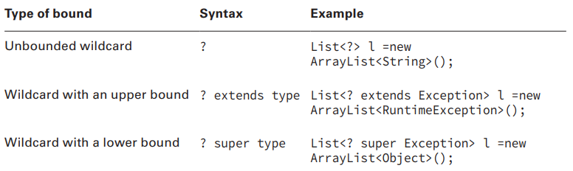
Generics bounds
A bounded parameter type is a generic type that specifies a bound for the generic

Slide 14
Generics bounds. Unbounded wildcard
The wildcard “?” represents an unknown type. You can use it to declare the type of a parameter; a local, instance, or static variable; and return value of generic types. But you can’t use it as a type argument to invoke a generic method, create a generic class instance, or for a supertype.
class Book {}
public class Application {
public static void main(String[] args) {
List<?> wishList = new ArrayList<Book>();
// wishList.add(new Book()); <- won't compile
}
}

Slide 15
Generics bounds. Unbounded wildcard
public static void printList(List<?> list) { for (Object x : list) { // has access to Object methods System.out.println(x); } } public static void main(String[] args) { List<String> keywords = Arrays.asList("java", "OOP"); printList(keywords); // java OOP List<Integer> versions = Arrays.asList(1, 2); printList(versions); // 1 2 }

Slide 16
Generics bounds. Upper-Bounded Wildcards
You can restrict use of arguments to a type and its subtypes by using <? extends Type>, where Type refers to a class, interface, or enum. In upper-bounded wildcards, the keyword extends is used for both a class and an interface.
class Book {}
class HistoryBook extends Book {}
public class Application {
public static void main(String[] args) {
List<? extends Book> books1 = new ArrayList<>();
List<? extends Book> books2 = new ArrayList<HistoryBook>();
// List<? extends Book> books3 = new ArrayList<Object>(); won't compile
}
}

Slide 17
Generics bounds. Upper-Bounded Wildcards
// source
public static void printList(List<? extends Number> list) { for (Number x : list) { // has access to Number methods System.out.println(x.doubleValue()); } list.add(1); // not compiles }
// compiled
public static void printList(List list) { for (Object x : list) { Number num = (Number) x System.out.println(num.doubleValue()); } }
public static void main(String[] args) { List<Double> doubles = Arrays.asList(1.0, 2.0); printList(doubles); // 1.0 2.0
List<Integer> ints = Arrays.asList(1, 2); printList(ints); // 1.0 2.0 }

Slide 18
Generics bounds. Lower-Bounded Wildcards
You can restrict use of type arguments to a type and its base or supertypes by using <? super Type>, where Type refers to a class, interface, or enum. Consider the following classes:
class Book {}
class HistoryBook extends Book {}
public class Application {
public static void main(String[] args) {
List<? super Book> books1 = new ArrayList<>();
// List<? super Book> books2 = new ArrayList<HistoryBook>(); not compile
List<? super Book> books3 = new ArrayList<Object>();
}
}

Slide 19
Generics bounds. Lower-Bounded Wildcards
// source
public static void printList(List<? super Integer> list) { for (Object x : list) { // has access to Number methods System.out.println(((Number) x).doubleValue()); } list.add(1); // compiles }
// compiled
public static void printList(List list) { for (Object x : list) { Number num = (Number) x System.out.println(num.doubleValue()); }
list.add(1); // compiles }
public static void main(String[] args) { List<Integer> ints = Arrays.asList(1, 2); printList(ints); // 1.0 2.0 List<Number> nums = Arrays.asList(1.0, 2.0); printList(nums); // 1.0 2.0 }

Slide 20
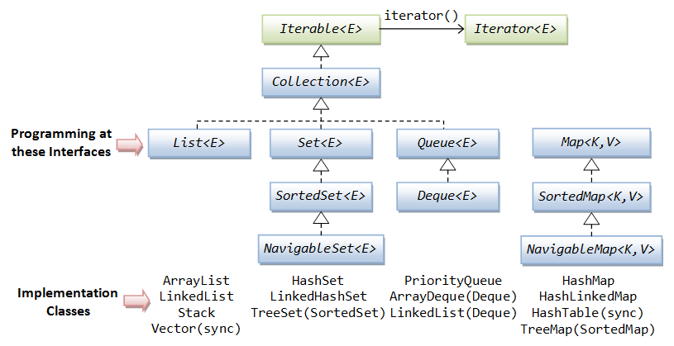
Collections Framework

Slide 21
equals
Reflexive
Symmetric
Transitive
Consistent
Null-safe
Notes:
Reflexive: For any non‐null reference value x, x.equals(x) should return true;
Symmetric: For any non‐null reference values x and y, x.equals(y) should return true if and only if y.equals(x) returns true;
Transitive: For any non‐null reference values x, y, and z, if x.equals(y) returns true and y.equals(z) returns true, then x.equals(z) should return true;
Consistent: For any non‐null reference values x and y, multiple invocations of x.equals(y) consistently return true or consistently return false, provided no information used in equals comparisons on the objects is modified;
For any non‐null reference value x, x.equals(null) should return false

Slide 22
hashCode
Whenever you override equals(), you are also override hashCode()
o1.equals(o1) -> o1.hashCode() == o1.hashCode()
o1.equals(o2) -> o1.hashCode() == o2.hashCode()
!o1.equals(o2) !-> o1.hashCode() != o2.hashCode()

Slide 23
Coding equals, hashCode and toString
class Bird { private final String name;
public Bird(String name) { this.name = name; } @Override public boolean equals(Object o) { if (this == o) { return true; } if (o == null || getClass() != o.getClass()){ return false; } Bird bird = (Bird) o; return Objects.equals(name, bird.name); } @Override public int hashCode() { return Objects.hash(name); } }

Slide 24
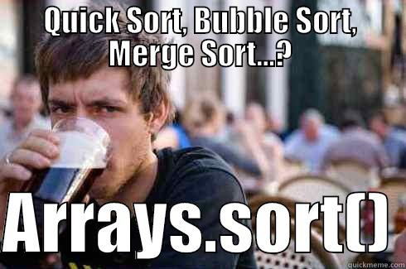
Collections class

Slide 25
Collections class
<T extends Comparable> T max(Collection<? extends T> coll); <T extends Comparable> T min(Collection<? extends T> coll); void reverse(List<?> list); void shuffle(List<?> list); <T> void copy(List<? super T> dest, List<? extends T> src); <T> List<T> synchronizedList(List<T> list); <T extends Comparable<? super T>> void sort(List<T> list); <T> void sort(List<T> list, Comparator<? super T> c);
<T extends Comparable> int binarySearch(List<? extends Comparable<? super T>> list, T key);

Slide 26
Comparable
class Animal { String name; Integer strength; // constructor
}
List<Animal> animals = new ArrayList<>(); animals.add(new Animal("cat", 3)); animals.add(new Animal("dog", 2)); animals.add(new Animal("elephant", 45));
Collections.sort(animals); // fails to compile
for (Animal animal : animals) { println(animal.getname()); }

Slide 27
Comparable
public interface Comparable<T> { int compareTo(T o); }
Zero is returned when the current object is equal to the argument to compareTo().
A number less than zero is returned when the current object is smaller than the argument to compareTo().
A number greater than zero is returned when the current object is larger than the argument to compareTo()

Slide 28
Comparable
class Animal implements Comparable<Animal> { String name; Integer strength; // constructor @Override public int compareTo(Animal other){ return name.compareTo(other.name); } }
List<Animal> animals = new ArrayList<>(); animals.add(new Animal("cat", 3)); animals.add(new Animal("dog", 2)); animals.add(new Animal("elephant", 45));
Collections.sort(animals);
animals.forEach(System.out::print); // cat dog elephant

Slide 29
Comparator
public interface Comparator<T> { int compare(T o1, T o2); }
Zero is returned when the arguments of compare() methods are equal.
A number less than zero is returned when the first argument is smaller than the second argument to compare()
A number greater than zero is returned when the first argument is greater than the second argument to compare()

Slide 30
Comparator
class Animal { String name; Integer strength; // constructor }
Comparator<Animal> animalComparatorByStrength = new Comparator<>() { @Override public int compare(Animal o1, Animal o2) { return o1.strength.compareTo(o2.strength); } }
List<Animal> animals = new ArrayList<>(); animals.add(new Animal("cat", 3)); animals.add(new Animal("dog", 2)); animals.add(new Animal("elephant", 45));
Collections.sort(animals, animalComparatorByStrength);
animals.forEach(System.out::print); // dog cat elephant

Slide 31
Literature
Generics
Collections Cheat sheet
Clean Code: A Handbook of Agile Software Craftsmanship by Robert C. Martin : Chapter 1-3

Slide 32
Homework Task 1
public interface Garage { /** * Returns cars list sorted by brand in alphabetical natural order, then * if brand equals sub-sorts by power descending, then * if brand and power the same – sub-sorts by Color luminosity ascending */ List<Car> getCars(); }
https://en.wikipedia.org/wiki/Relative_luminance

Slide 33
Homework Task 2
public interface TaskManager { int addTask(Task task); // returns tasks count after insertion boolean removeTasks(LocalDate date); // returns was task removed Set<String> getCategories(); // returns unique tasks categories Map<String, List<Task>> getTasksByCategories(); // tasks sorted descending by date List<Task> getTasksByCategory(String category); // tasks sorted descending by date List<Task> getTasksForToday(); // returns tasks sorted ascending by category List<Task> getAllTasks(); } class Task { private final String category; private final String description;
private final LocalDate date; /*..getter-setter..*/ }

Slide 34
Q&A

